Slide 1
Follicular lymphoma
Dr Nasrin Gholami
Hematologist ,Medical Oncologist Tabriz Medical University
Updates on lymphoma and transplantation
Webinar ,september 2020

Slide 2
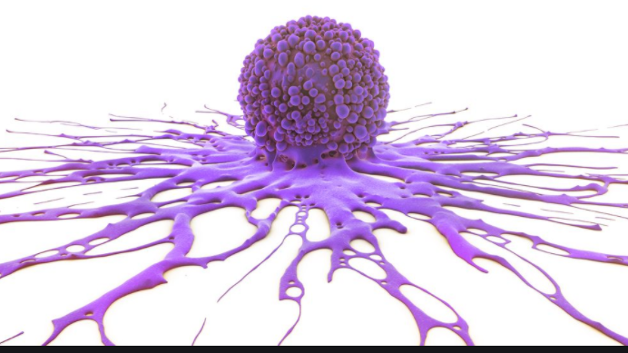

Slide 3
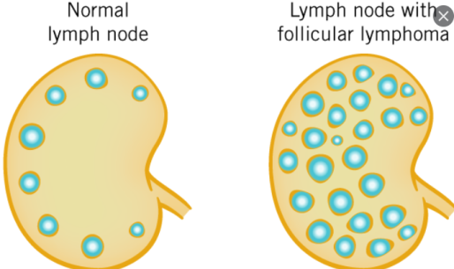
Follicular lymphoma (FL) is the second most common subtype of non-Hodgkin lymphoma.
Follicular lymphoma is a heterogeneous clinicopathologic entity that includes tumors derived from germinal center B cells,
The molecular pathogenesis of FL is a complex, multistep process needed for malignant transformation.

Slide 4
The annual incidence of this disease has rapidly increased during recent decades and has risen from 2–3/100 000 during the 1950s to 5/100 000 recently.
keeping in mind the possible heterogeneity of FL grading can be difficult to appreciate on core biopsies and re-biopsy may be required if the material is not adequate. Fine needle aspirations are inappropriate for a reliable diagnosis.

Slide 5
The germinal center ancestry of these cells is principally supported by the identifcation of somatic mutations in the variable region of the immunoglobulin genes (IgVH), which serves as a marker of germinal center transit
The development of the majority of FL tumors in adults is dependent on the overexpression (BCL-2) located on chromosome band 18q21.

Slide 6
In contrast to most proto-oncogenes, BCL-2 has little or no ability to promote cell cycle progression or cell proliferation, but rather raises the cellular apoptotic threshold, thereby inhibiting apoptosis.
How BCL-2 translocations contribute to the development of FL is complex.

Slide 7
These observations clearly indicate that BCL-2/IgH translocations are not sufficient to cause FL, and that other genetic or epigenetic events are rate limiting for its development.

Slide 8
While not all patients with the translocation developed FL, and not all patients who developed FL had the translocation in pre-diagnostic blood samples, samples from those who went on to develop FL were more likely to be positive (56 versus 29 percent).
BCL-2 negative cases
Less than 10 percent of FL tumors do not harbor BCL-2 translocations. (Grade 3b FL).

Slide 9
Approximately 90 percent of FL demonstrate genetic alterations in addition to the t(14;18) translocation . The most common are loss of 1p, 6q(20% with poor prognosis), 10q, and 17p and gains of chromosomes 1, 6p, 7, 8, 12q, X, and 18q/dup.

Slide 10
EPIDEMIOLOGY
In all races and geographic locations. The exact worldwide incidence of FL is not known.
FL most frequently presents in middle-aged individuals and the elderly, with a median age at diagnosis of 65 years

Slide 11
CLINICAL FEATURES
Painless peripheral adenopathy in the cervical, axillary, inguinal, and/or femoral regions
Hilar and mediastinal nodes are often involved, large mediastinal masses are rare
most patients are asymptomatic other than for lymph node enlargement
Only approximately 20 percent present with B symptoms.

Slide 12
25 percent of patients present with an increased serum lactate dehydrogenase (LDH) or cytopenias in the peripheral blood
Involvement of organs other than the lymphatic organs or bone marrow is uncommon
Disease localized to the small intestine, most commonly the second portion of the duodenum.

Slide 13
Grade
Aggressiveness of the tumor increases with increasing numbers of centroblasts.
Grade 1 0 to 5 centroblasts/HPF
Grade 2 6 to 15 centroblasts/hpf
Grade 3 More than 15 centroblasts/hpf

Slide 14
Immunophenotype
The tumor cells usually demonstrate surface immunoglobulin
Virtually all cases express HLA-DR, are positive for certain pan B cell antigens (CD19, CD20, CD79a), CD21, and CD10 (60 percent), and lack expression of CD5, CD43 (most cases), and CD11c. CD23 expression is variable

Slide 15
Cytoplasmic staining for BCL-2 protein is strongly positive in almost all grade 1/2 tumors.
BCL6 is expressed by at least some of the neoplastic cells in all FL tumors.(5-15%)

Slide 16
DIFFERENTIAL DIAGNOSIS
PROGNOSIS
Follicular lymphoma IPI (FLIPI)
The addition of rituximab to standard chemotherapy has resulted in signifficant improvements in the OS rates of CD20- positive tumors. Subsequent studies indicate the usefulness of the FLIPI in assessing prognosis in patients with FL treated with rituximab-containing therapy.

Slide 17
FLIPI2
A simplifed version of the FLIPI2 (the PRIMA-PI score) that can be calculated using the serum beta-2 microglobulin level and an assessment of bone marrow involvement
m7-FLIPI

Slide 18
Microenvironment
Studies point to the possibility that variation in the host immune response to cancer cells in the local microenvironment influences prognosis in a number of malignancies, including FL. These associations suggest that "crosstalk" between the neoplastic B cells and benign immune cells in the microenvironment has a strong bearing on the pathobiology of FL

Slide 19
Cytogenetics
t(14;18)
t(2;18)
t(18;22)
The t(14;18) translocation is not specific for FL, as it is also found in up to 30 percent of diffuse large B cell lymphomas and in a small number of reactive germinal center B cells in many lymph nodes undergoing follicular hyperplasia

Slide 20
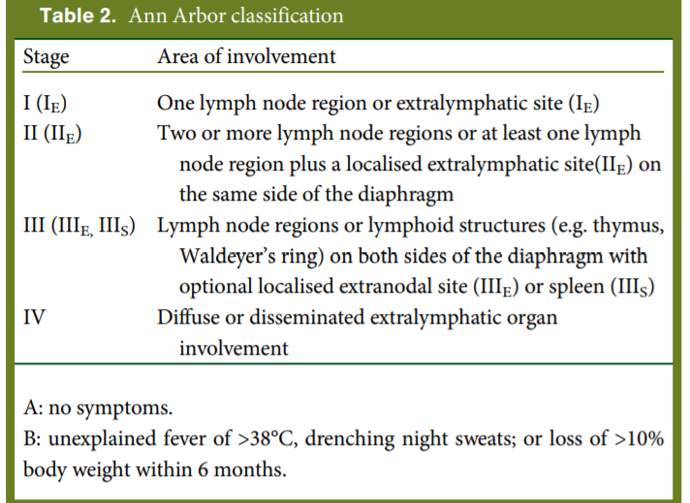

Slide 21
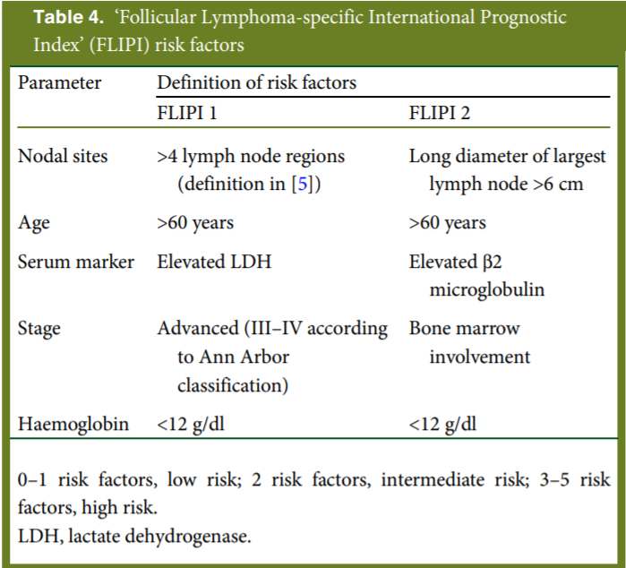

Slide 22
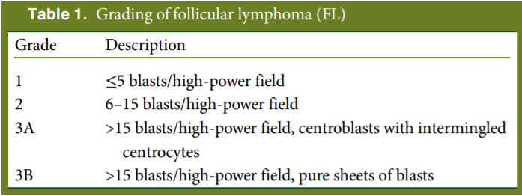

Slide 23
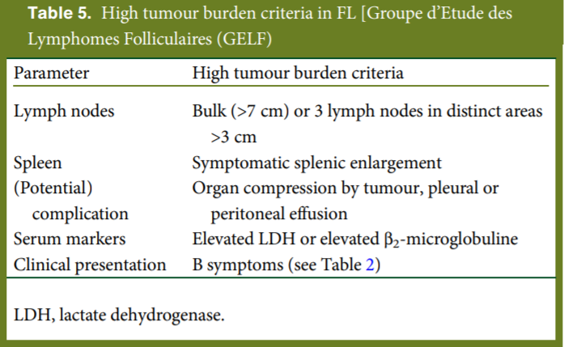

Slide 24
We follow asymptomatic patients in clinic every three months for the first year and then every three to six months thereafter until progressive disease is noted.
Several randomized trials comparing chemotherapy regimens of different intensities with a watch-and-wait strategy followed by chemotherapy at the time of progression support the use of an initial period of observation for asymptomatic patients with low volume disease

Slide 25
This approach does not jeopardize survival, and a prolonged treatment-free period may decrease the potential for drug resistance by avoiding exposure of the tumor to chemotherapy. In contrast, a large international randomized trial comparing watchful waiting versus initial treatment with rituximab suggested that initial treatment with rituximab may improve quality of life (ie, decrease anxiety) and postpone cytotoxic chemotherapy without impacting OS .

Slide 26
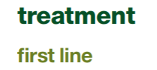
stage I–II. In the small proportion of patients with limited non-bulky stages I–II, radiotherapy (involved field, 24 Gy) is the preferred treatment with a potentially curative potential

Slide 27
In stage I–II patients with large tumour burden, adverse clinical or biological prognostic features or when local radiotherapy is not applicable (e.g. lung, liver), systemic therapy as indicated for advanced stages should be applied

Slide 28
Natural course of the disease is characterised by spontaneous regressions in 10%–20% of cases and varies significantly from case to case, therapy should be initiated only upon the occurrence of symptoms, including B symptoms, haematopoietic impairment, bulky disease, vital organ compression, ascites, pleural effusion or rapid lymphoma progression .

Slide 29
Trials before the rituximab era, an early initiation of therapy in asymptomatic patients did not result in any improvement of disease-specific survival or overall survival (OS)
In a more recent study, early initiation of rituximab resulted in improved PFS (80% versus 48%).

Slide 30
Four prospective first-line trials, two salvage trials and a systematic meta-analysis confirmed an improved overall response, PFS and OS if rituximab was added to chemotherapy.

Slide 31
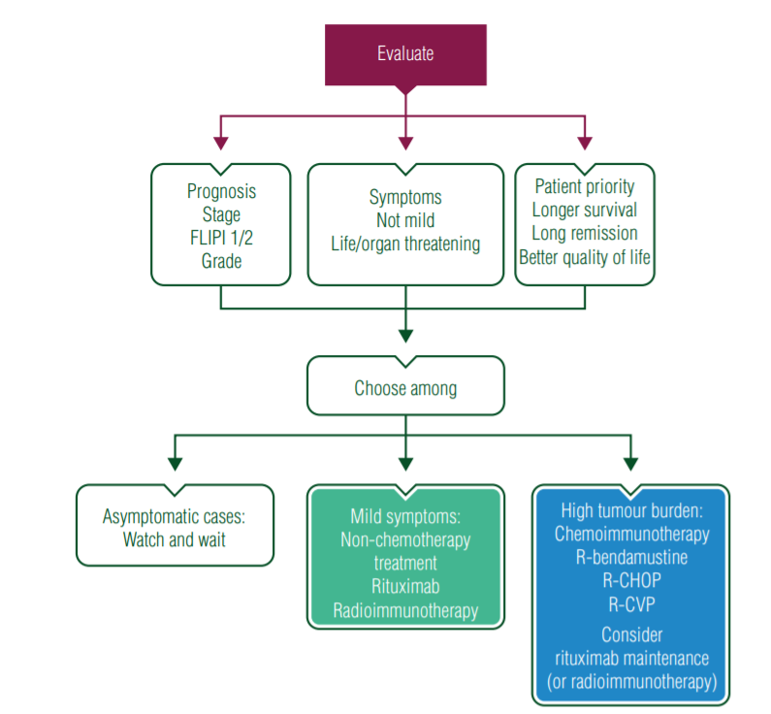

Slide 32
Rituximab maintenance for 2 years improves PFS (59% versus 43% after 6 years, P < 0.0001.
Maintenance therapy prolongs PFS; there is no OS benefit and no change in transformation rate.

Slide 33
whereas a shorter maintenance period results in inferior benefit.
Radioimmunotherapy consolidation also prolongs PFS after chemotherapy, but its benefit seems to be inferior in comparison with rituximab maintenance for 2 years

Slide 35
Myeloablative consolidation followed by autologous stem cell transplantation (ASCT) prolongs PFS after chemotherapy,(in first line therapy) but its benefit after a rituximab-containing induction is minor and no OS has been observed . Therefore, such an approach is not recommended in first-line therapy of responding patients .

Slide 36
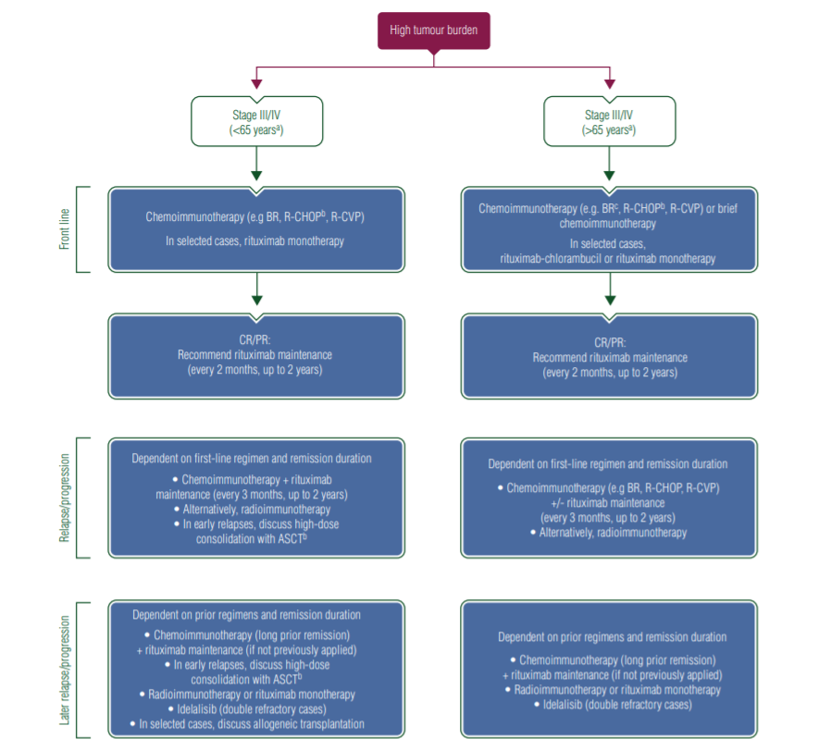

Slide 37
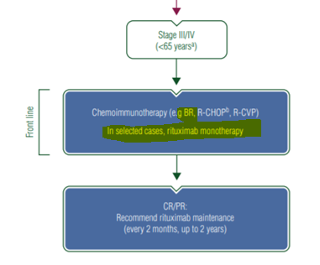

Slide 38
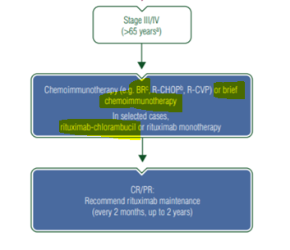

Slide 39
There is a paucity of data regarding the use of BR in patients with the more aggressive histologic grade 3a disease; R-CHOP may be preferred in this setting for patients with clinically aggressive disease.

Slide 40
has been used in combination with bendamustine, CHOP, and CVP, followed by obinutuzumab maintenance. In one study, this strategy improved PFS, but was associated with increased toxicity and cost

Slide 41
Reserve this regimen for patients with relapsed or refractory FL.

Slide 42
At relapse, it is strongly recommended to obtain a new biopsy in order to exclude transformation into an aggressive lymphoma.
Selection of salvage treatment depends on efficacy of prior regimens.
We recognize such patients as having early treatment failure defined as progression within 24 months of immunochemotherapy or within 12 months of single-agent Rituximab.

Slide 43
Patients with asymptomatic recurrent FL do not necessarily require immediate treatment, but should be followed closely for the development of symptomatic disease. Patients with symptomatic FL or those with an increase in disease tempo require treatment.

Slide 44
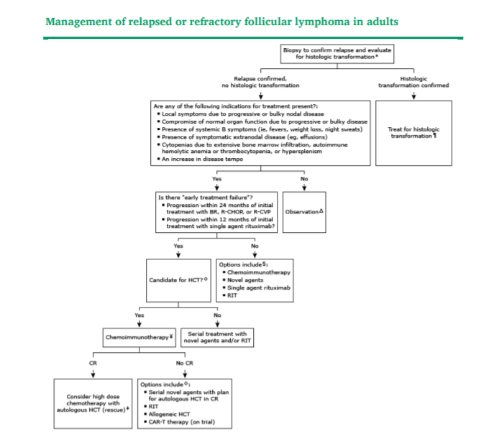

Slide 45
Non-cross-resistant scheme should be preferred (e.g. bendamustine after CHOP or vice versa). Other options, including fludarabine-based, platinum saltsbased or alkylating agents-based regimens, could also be useful.
Rituximab should be added if the previous antibody-containing scheme achieved >6- to 12-month duration of remission .

Slide 46
Radioimmunotherapy (90yttrium–ibritumomab–tiuxetan) may represent an effective therapeutic approach in elderly patients with comorbidities not appropriate for chemotherapy

Slide 47
Rituximab maintenance for up to 2 years has a favourable side-effect profile and, based on a systematic meta-analysis, substantially prolongs PFS and OS in relapsed disease, even after antibody-containing induction in patients who have not received antibody as first-line therapy

Slide 48
A second-line maintenance treatment has not been investigated in the setting of maintenance use in first line and probably should not be used for those patients who had relapsed during their first maintenance period .

Slide 49
High-dose chemotherapy with ASCT prolongs PFS and OS and should be considered, especially in patients who experience short-lived first remissions (less than 2-3
Its general role in the rituximab era has to be redefined.

Slide 50
The PI3K inhibitor idelalisib has been registered in double-refractory FL, based on a phase II study.
In selected younger patients with later relapses of high-risk profile or relapse after ASCT, a potentially curative allogeneic stem cell transplantation ( preferably with dose-reduced conditioning) may be considered, especially in patients with early relapse and refractory disease .

Slide 51
Outside of a clinical trial, HCT is reserved for patients with relapsed or refractory FL and for those with histologic transformation to a more aggressive histology. Novel cellular therapies, such as chimeric antigen receptor T cells, may replace HCT for this population in the future.

Slide 52
Survival advantages seen in some early trials of HCT may not have been evident had the combination chemotherapy treatment arms included anti-CD20 monoclonal antibodies.
Conversely, a lack of survival advantage seen in other early trials may have been because the patients did not receive sufficient chemotherapy immediately before transplantation.

Slide 53
Small retrospective studies suggest that autologous HCT may improve progression-free survival (PFS) and overall survival (OS) in patients with early treatment failure if they are in complete remission or have minimal disease at the time of HCT. Larger studies are needed to confirm a benefit. Since the efficacy of autologous HCT depends on the response to chemotherapy, autologous HCT is not appropriate for chemotherapy-resistant disease.

Slide 54
Retrospective analyses comparing autologous HCT versus chemoimmunotherapy for the larger population of patients with relapsed FL in the rituximab era have had mixed results

Slide 55
The 10-year PFS is consistently in the 30 to 50 percent range. There is a plateau in the survival curves between 10 and 15 years after autologous HCT, suggesting that this procedure may be curative for one-quarter to one-third of transplanted patients.

Slide 56
While some have demonstrated improvements in PFS, none has shown an OS benefit. These trials are presented in more detail separately

Slide 57
In patients without rituximab resistance, maintenance rituximab after autoHCT improves progression free survival (PFS). Toxicities are increased and the effect on overall survival (OS) is not clear.
Uptodate suggests maintenance rituximab rather than observation for patients with relapsed or refractory FL without evidence of rituximab resistance(less than 6 mon)

Slide 58
Autologous HCT has been associated with a treatment-related mortality rate of less than 10 percent and a potential cure rate of up to 25 to 40 percent. As with other malignancies, peripheral blood progenitor cells are preferred over bone marrow harvested grafts

Slide 59
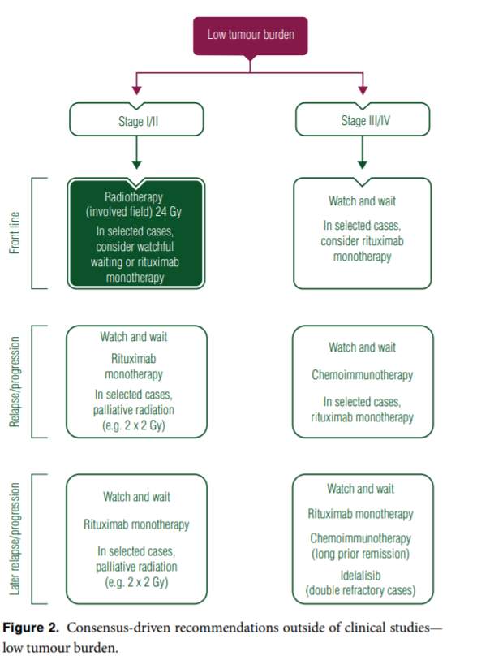

Slide 61
The ideal timing of HCT in FL is unknown and controversial. Ideally, allogeneic HCT should be performed within the context of a clinical trial.

Slide 62
In most centers in the United States, patients are considered eligible for nonmyeloablative allogeneic HCT if they are less than 70 years of age, with normal cardiac, liver, and renal function, and have a good performance status (ECOG performance status 0 or 1). For myeloablative allogeneic transplantation, eligibility is more restrictive in that patients should typically be less than 55 years of age.

Slide 63
Even with nonmyeloablative or reduced intensity allogeneic HCT, the treatment-related mortality at two to three years ranges from 15 to 25 percent and largely re%ects deaths from GVHD and infectious complications.
Predictors of worse outcome included older age, >3 prior lines of therapy, chemotherapy-resistant disease, and impaired performance status.

Slide 64
The use of allogeneic HCT is limited since even ideal candidates who undergo allogeneic HCT have a high rate of treatment-related mortality and nontransplant treatment options have expanded over recent decades. In addition, chimeric antigen receptor modiffed T cell therapy is being studied in patients with FL and may replace allogeneic HCT for a subset of patients.

Slide 65
When compared with autologous HCT, allogeneic HCT is associated with a higher treatment-related mortality rate (15 to 25 percent), but a higher potential rate of cure (50 to 60 percent.
Treatment options for relapsed FL after an allogeneic HCT include reduction of immunosuppression, donor lymphocyte infusion, and treatment with salvage chemotherapy.

Slide 66
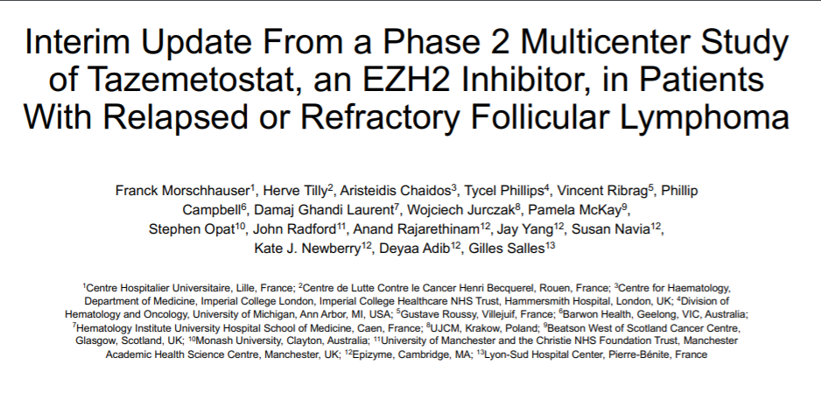

Slide 67
